Slide 1
Healthcare Information Systems Project
Lung Cancer Smart Decision
Doron Gusenberg, Yuval Luria, Omer Haziza

Slide 2
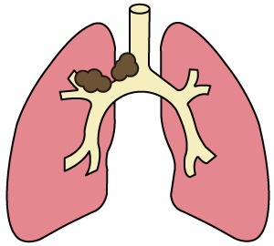
The Problem
Lung Cancer
Lung cancer is one of the most common types of cancer, and it is responsible for more deaths than any other type of cancer worldwide.
The most common cause of lung cancer is smoking, but other factors, can also increase the risk of developing lung cancer. Symptoms of lung cancer may include coughing, chest pain, shortness of breath, hoarseness, and coughing up blood.
Treatment for lung cancer depends on the type and stage of the cancer. Surgery, radiation therapy, chemotherapy, and immunotherapy are all options for treating lung cancer.
The earlier the cancer is detected, the more treatment options are available, and the better the chances of successful treatment.

Slide 3
The Problem
Lung Cancer
Related Illnesses to Lung Cancer
Chronic Obstructive Pulmonary Disease (COPD): This is a chronic lung disease that includes chronic bronchitis and emphysema. People with COPD are at increased risk of developing lung cancer, especially if they also smoke.
Tuberculosis (TB): TB is a bacterial infection that primarily affects the lungs. People who have had TB in the past may be at increased risk of developing lung cancer, possibly due to damage to the lung tissue caused by the infection.
Pulmonary fibrosis: This is a condition in which the lung tissue becomes scarred, making it difficult for the lungs to function properly. People with pulmonary fibrosis may be at increased risk of developing lung cancer.
Cardiovascular disease: Lung cancer and cardiovascular disease share several risk factors, such as smoking, and people with Cardiovascular disease may also have an increased risk of developing lung cancer.

Slide 4




The Motivation
Improved patient outcomes
By providing doctors with better access to data, they can make more informed decisions about treatment options and provide more personalized care to each patient.
Better understanding of risk factors
By analyzing the big data storage - we can identify high-risk groups and inform strategies for prevention and early detection.
Increased efficiency
Improved treatment development
This can save time and resources for healthcare providers, allowing them to focus on providing care to patients.
The project can help identify which treatments are most effective and for which patients. This can inform the development of new treatments and improve overall treatment outcomes.

Slide 5
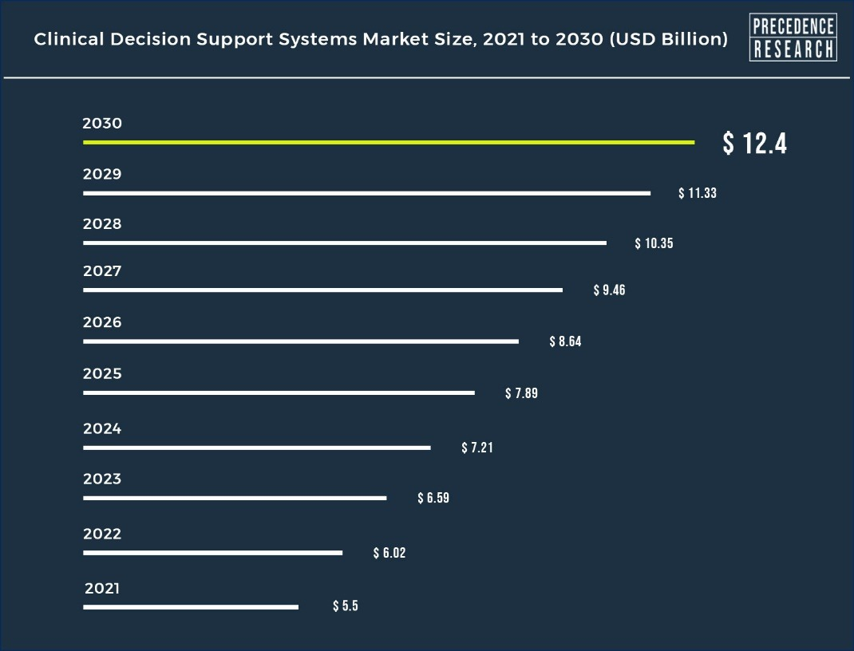
The Motivation - Growing Market

Slide 6


Market Survey
Cerner provides decision support systems and clinical decision support tools that enable hospitals to optimize workflows, improve patient outcomes, and enhance operational efficiency through data-driven insights.
IBM Watson Health provides AI-powered decision support systems for hospitals, combining cognitive computing and data analytics to help healthcare providers analyze vast amounts of data and generate actionable insights for better decision-making.
In our system – “ Lung Cancer Decision Support System” we have an advantage comparing to the known decision support systems – we focus on Lung Cancer.
The features are dedicated to support decision of diagnosis lung cancer – it could help with get the decision faster and more accurate.
Lung Cancer Decision Support System

Slide 7
Queries
Insert
Remove
Search
A buttons that allows the user to enter a new patient / doctor / procedure session to the database.
A buttons that allows the user to remove a patient / doctor from the database.
A buttons that allows the user to search a patient / doctor in the database.

Slide 8
Queries
Change Status
Sorting
Most Treated Patients
Busiest Month
A buttons that allows the user to change the patient illness status (0 –sick, 1 - healthy, 2 - become healthy, 3 - dead).
In this query we can sort the patient database according to all features that describe him in our database.
A query that present the patients that had the largest number of treatments.
A query that shows what are the busiest months of the ward activity.

Slide 9

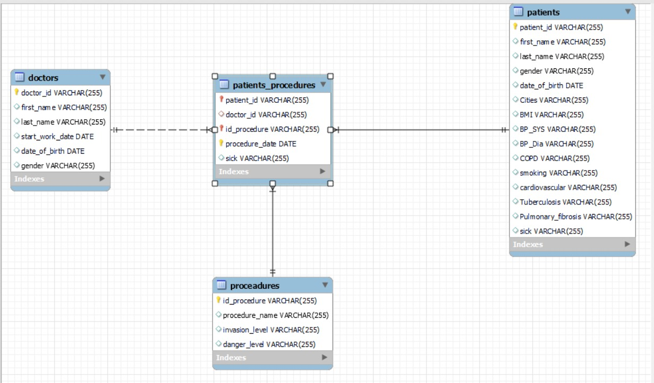
ERD

Slide 10
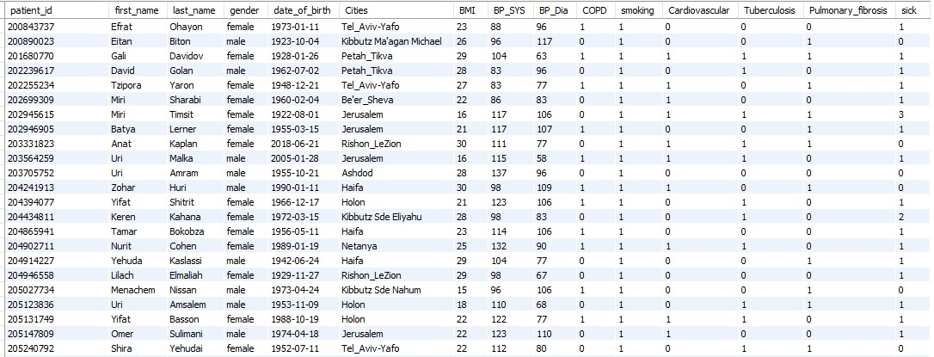
Patients
PK’s : patient_id.
COPD, tuberculosis, Pulmonary fibrosis, hereditary retinoblastoma are illnesses that correlated to lung cancer.
Sick column is saying the patient status: 0 – healthy, 1 – active sick , 2- healed, 3 – dead.

Slide 11
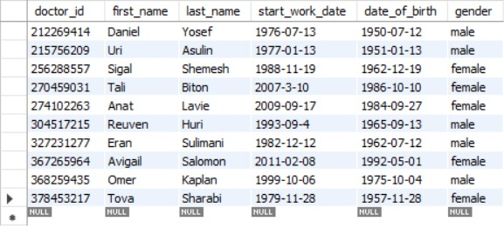
Doctors
PK’s : doctor_id

Slide 12
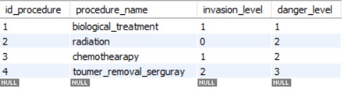
Procedures
PK’s : id_procedure

Slide 13
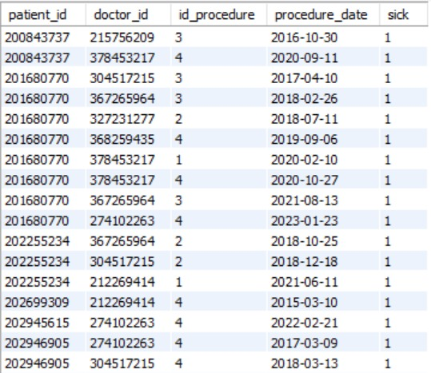
Patients_Procedures
Pk’s: patient_id, id_procedure, Procedure_date.
Fk’s: patient_id, doctor_id, id_procedure, Procedure_date.

Slide 14
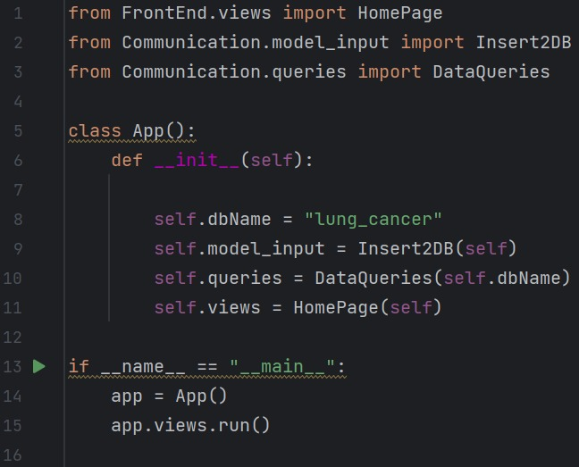
Controller – ‘App’:
We can observe that ‘app’ is the connection between all our files.

Slide 15
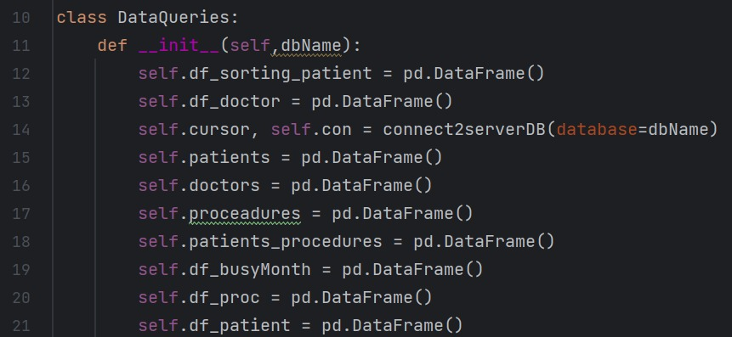
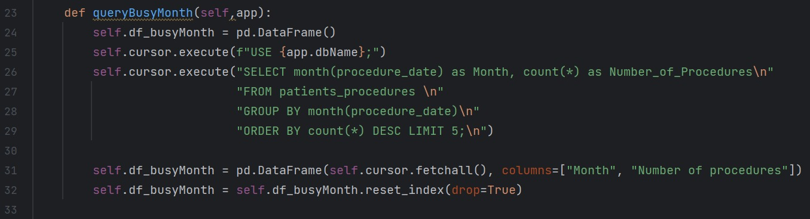
Model – ‘Queries’:
We can observe that ‘Queries’ store our updated dataframes.
We can see an example presented the use of a dataframe from the class attribute and the way it updated

Slide 16
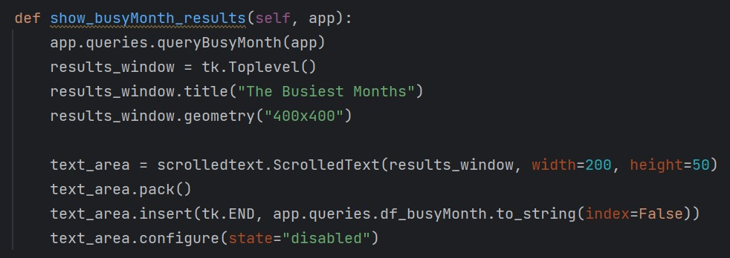
View – ‘View’:
In this file we can see how we summon the update dataframe from ‘queries’ through ‘app’

Slide 17

לינק לסרטון

Slide 18
Conclusion
Working on a full stack project on this course, we learned for the first time how to work with Python and MySQL together. We met for the first time the MVC Architecture. We understand that the inherited attribute is one of the most important abilities in a well written code.
We learned how to create Front End using Tkinter library.
We learn how to manage the front-end and back-end components, effective data handling, modular code organization, and user-friendly interface development.

Slide 19
Suggestions for improving the system
Add more queries that can present the conclusions from the data to be more clearly.
To improve the system, we thought about using AI Model that will help with predicting lung cancer detection using machine learning capabilities.
Consider changing this system to be a web application and thus support cloud capabilities, larger storage that could give us the opportunity to use more features and save more information.

